Slide 1

Alameda County
Health Care System Overview
To the Local AGENCY Formation Commission (lafco)
September 8, 2016
ALAMEDA COUNTY
HEALTH CARE SERVICES AGENCY
Rebecca Gebhart, Interim Agency Director
Health Care Services Agency

Slide 2
ALAMEDA COUNTY
HEALTH CARE SERVICES AGENCY
Overview
Alameda County Health Care Services Agency
Health care definitions
Components of a health system
Alameda County’s system
Payer mix in Alameda County
What is the safety net?
What are the issues facing the safety net?
2

Slide 3
ALAMEDA COUNTY
HEALTH CARE SERVICES AGENCY
VISION
Health Equity through the goals of
Healthy People, Healthy Places, Healthy Policies and Healthy Systems
MISSION
Provide fully integrated health care services through a comprehensive network of public and private partnerships that ensures optimal health and well-being and respects the diversity of all residents

Slide 4

ALAMEDA COUNTY HEALTH CARE SERVICES AGENCY
Office of the Director  Finance & Administration  Medical Director
Human Resources  Fund Development  Policy  Evaluation
HCSA Administration/
Indigent Health
Behavioral Health Care Services
Public Health Services
Environmental Health
Indigent Health Services/HealthPAC
Administration
Office of the Director Health Officer
Administration
Center for Healthy
Schools and Communities
Environmental Health
Services
24 Hour Services
Outpatient Services
Administrative Services
Communicable Disease Control & Prevention
Emergency Medical
Services
Vector Control
Services
Referral Services
Support Services
Family Health Services
Community Health Services
Cross-Departmental/
Cross-Jurisdictional Health Services
Day Treatment
Ancillaries
Public Health Nursing
Office of AIDS
Outreach

Slide 5
Mandated and Discretionary Services
HCSA Department | Mandated Services | Discretionary Services
Indigent, Cross-Jurisdictional, and Emergency Health | Indigent Health, Medical Services to Youth in Custody, Emergency Medical Services | School Health Services, Children’s Policy, Court Appointed Special Advocates, Youth Centers, Children’s Dental, Health Insurance Enrollment, MAA/TCM, Health Care for Low Income Uninsured, Health Care for the Homeless
Behavioral Health | Alcohol and Other Drug Services, Mental Health Services, Medi-Cal Consolidation | Housing Support for Homeless, Vocational Training, Self-Help and Empowerment, Crisis Support for the Uninsured
Environmental Health | Food/Water/Recreational Safety, Hazardous Materials/Waste Mgmt, Vector Control, Land Use/Septic, Solid/Medical Waste, Body Arts, Epidemiological Investigations, Complaints | Green Business/Community Environmental Health Services, Healthy Nail Salons, Pharmaceutical Safe Take Back, Food Facilities Grading System

Slide 6
Mandated and Discretionary Services
HCSA Department | Mandated Services | Discretionary Services
Public Health | Health Officer, Public Health Nursing, Public Health Laboratory, Public Health Statistics, Health Education, Communicable Disease Control & Surveillance, Disability Prevention, Child Health, Nutrition Services, Diabetes Prevention, Foster Care Health, Maternal & Infant Health, Dental Health, Tobacco Control | Asthma Program, Developmental Disabilities Planning & Advisory, Pregnancy Prevention, Teen Dating Violence Prevention, Home Visiting & Family Support System, Social & Health Equity Programs

Slide 7
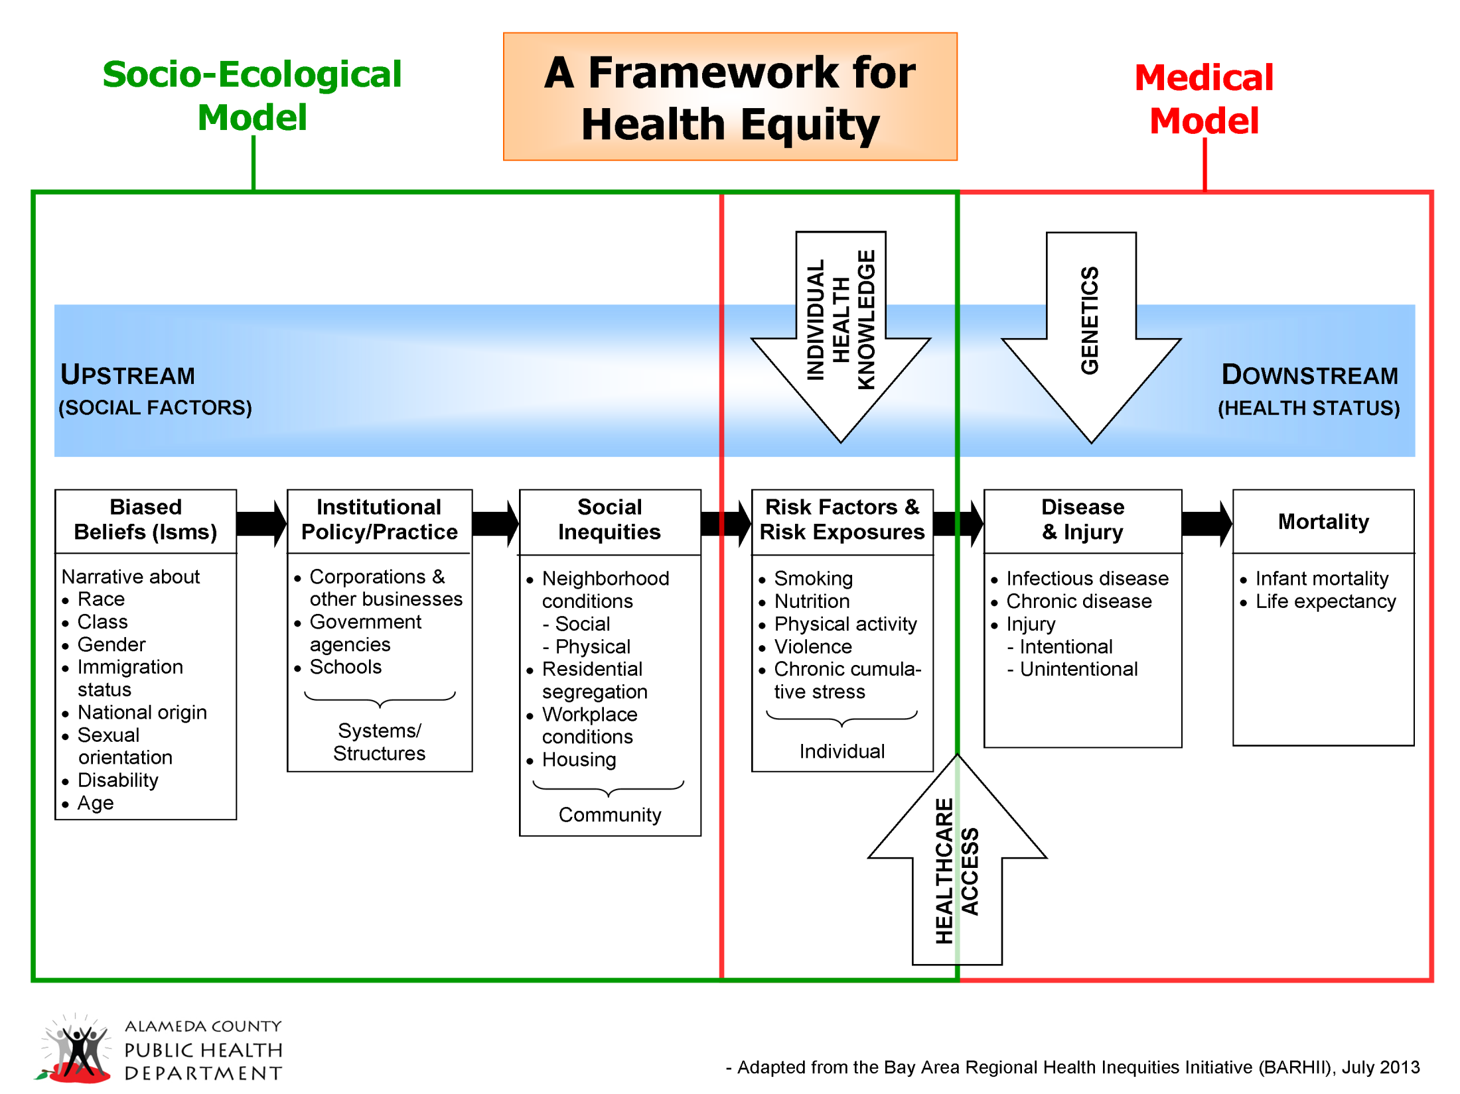
Evolving Definitions of Health care

Slide 8
Basic Components of a
Health Care Delivery System
Public Health (including health promotion and disease prevention)
Emergency Medical Services (911 and ambulances)
Ambulatory Care (primary and specialty)
Behavioral Health Services (in-patient and ambulatory)
Dental Services
Acute Care Hospitals
Long-term Care (either in-home or institutional care)*
Rehabilitation Services
Pharmacy, medical devices and equipment
*Not covered as a safety net service

Slide 9
Sources of Health Data
Health insurance breakdown information from California Health Interview Survey (CHIS):
  2015 updates coming in late October
Hospital Utilization Data from OSHPD (Office of Statewide Health Planning and Development):
  2015 updates coming in mid-September

Slide 10
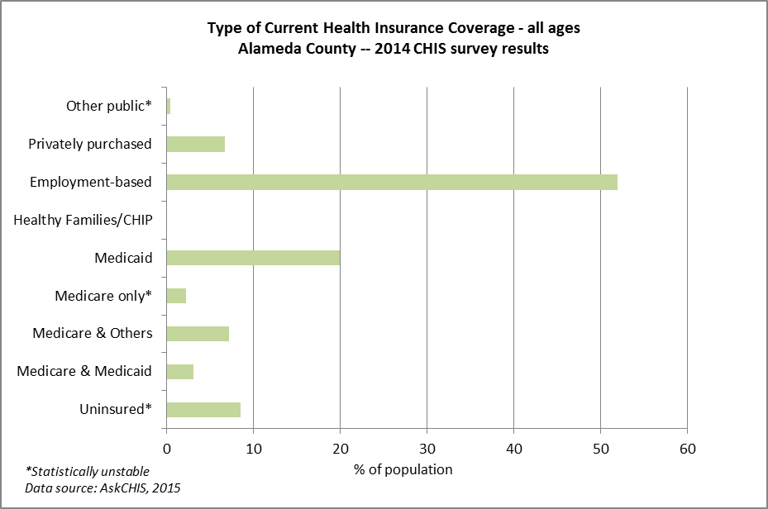
What is the Payer Mix in Alameda?

Slide 11
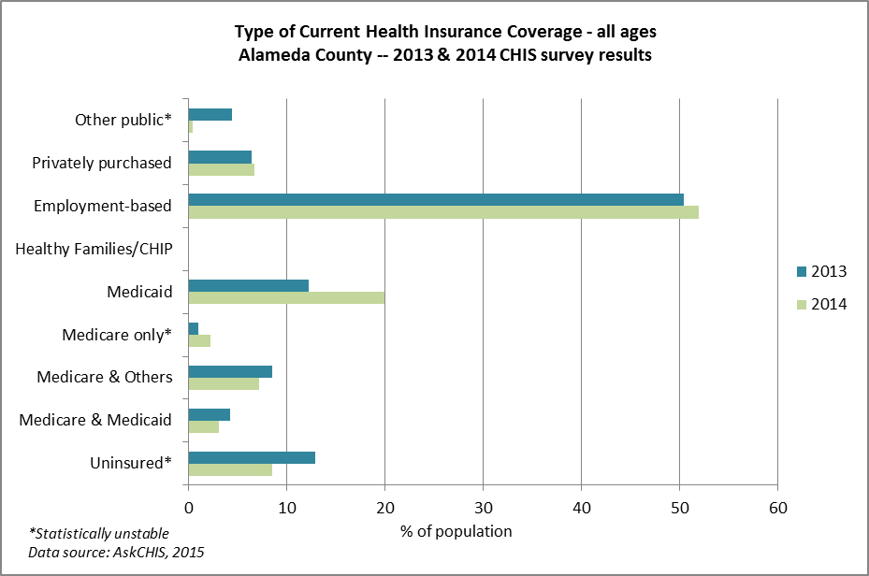
What is the Payer Mix in Alameda County? 2013 vs 2014

Slide 12
Health care System in Alameda County Major Providers
Hospitals and Hospital Systems
Kaiser
Sutter Health
  Sutter Health East Bay
  Eden
Alameda Health System
ValleyCare Hospital
Washington Hospital
St Rose Hospital
Fremont Hospital
UCSF Benioff Children’s Hospital
Large Medical Groups
Sutter Health
Hill Physicians
Stanford
Children First Medical Group
Community Health Center Network (CHCN)
VA Outpatient

Slide 13
Inpatient Visit Payer Source:
Alameda County Acute Care Facilities, 2014
13
*Data is incomplete for Kaiser Hayward/Fremont, which is included in Kaiser Facilities (½ year of data available only, so multiplied by 2 to estimate full year)
Source: OSHPD, 2014: http://report.oshpd.ca.gov/

Slide 14
What are Safety Net Services?
Services for Medi-Cal and Uninsured
Public Health (including health promotion and disease prevention)
Emergency Medical Services (911 and ambulances)
Ambulatory Care (primary and specialty)
Behavioral Health Services (in-patient and ambulatory)
Dental Services
Acute Care Hospitals
Rehabilitation Services
Pharmacy, medical devices and equipment

Slide 15
Alameda County Safety Net Relationships
1980
The County
Admin and Indigent Health
Public Health
Highland
Fairmont
Freestanding
clinics
EMS
Behavioral Health
Contracted Providers (FQHCs)
Contract $
Asian
La Clinica
Tri-City
Tiburcio Vasquez
Valley Community
West Oakland
Over 60
Native American
Health Care
Services Agency
Alameda Health Consortium*
* AHC is a membership organization of the clinics that does policy and advocacy work

Slide 16
Alameda County Safety Net Relationships
1996
Medi-Cal Managed Care Plan
Alliance
Moms and kids
The County
Public Health
Contracted Providers
Contract $
Asian
La Clinica
Tri-City
Tiburcio Vasquez
Valley Community
West Oakland
Lifelong
Native American
Health Care
Services Agency
Behavioral Health
Admin and Indigent Health
Alameda Health Consortium*
Community Health Center Network CHCN
ACMC
Highland
Fairmont
John George Psych
Clinics
EMS

Slide 17
Alameda County Safety Net Relationships
2016
Medi-Cal Managed Care Plan
Alliance
Public Health
The County
Moms, kids, disabled adults and new, expansion Medi-Cal
Contracted Providers
Health Care
Services Agency
Asian
La Clinica
Tri-City
Tiburcio Vasquez
Axis
West Oakland
LifeLong
Native American
Contract $
Behavioral Health
Admin and HealthPAC
Alameda Health Consortium*
Community Health Center Network CHCN
AHS
Highland
Fairmont
San Leandro
Alameda
Clinics
Environmental Health
EMS

Slide 19
Medi-Cal and the
Remaining Uninsured
Alameda County 2016
Medi-Cal in managed care (as of 8/1/16) 316,518
Medi-Cal fee for services (estimate) 79,000
Undocumented Children Eligible for Medi-Cal 8,000
Medi-Cal Total 403,518
Uninsured:
  Not Eligible due to Immigration Status 65,000
  Eligible for Medi-Cal < 5,000
  Eligible for Subsidies through Covered CA < 5,000
  Non-subsidy Eligible Citizens & Lawfully Present Immigrants 17,000
  Total Uninsured 84,000
  Total Safety Net population approximately 487,518
Uninsured data source: Preliminary CalSIM v 2.0 Regional Remaining Uninsured Projections August 2016

Slide 20
Efforts to Meet Demand
Planning for Additional Senior Services
Focus on prevention and social determinants of health such as:
  Housing
  Nutrition
  Exercise
Special Services for Frequent Utilizer Groups
  Health homes via the managed care plans
  Whole person care

Slide 21
Health Care Challenges
Aging Population
Cost of Health Insurance
Low Medi-cal Reimbursements
Pent up Demand for Health Care Services
Hospital Closures
Integrating Mental Health and Substance Abuse Treatment into Primary Care
Transition to Electronic Health Records
Availability of and Access to Primary Care

Slide 22
QUESTIONS?

